Slide 1
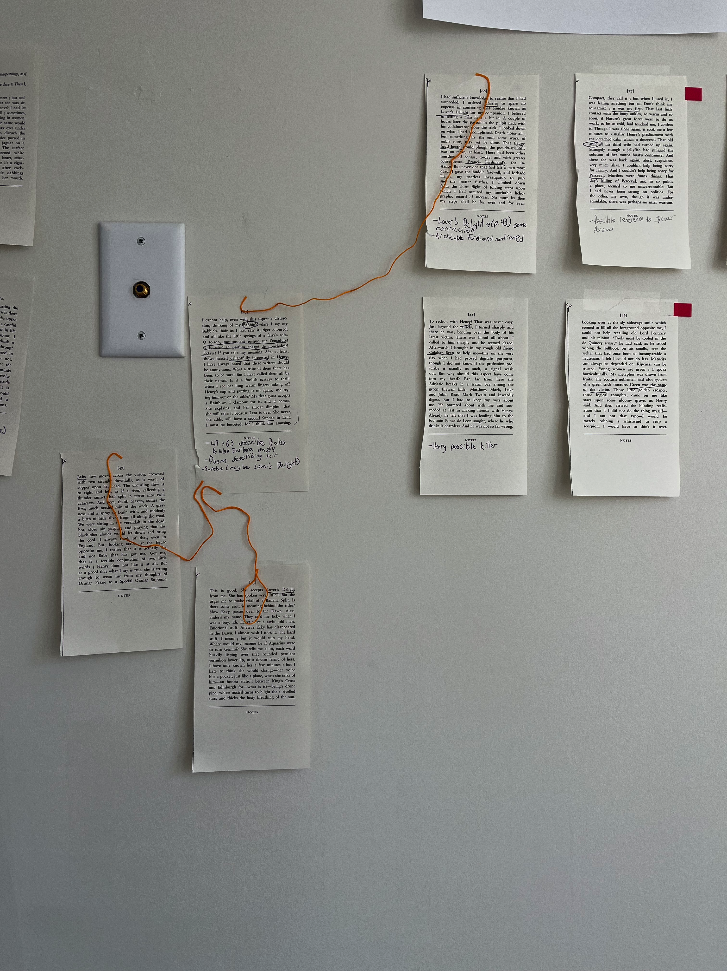
Cain’s Jawbone Literary Puzzle
Released in 1930, only 4 people have ever solved correctly
100 Pages out of order, 100! combinations
6 Murderers, 6 Victims, Unknown number of narrators
Using Graph to streamline fact finding, decision making, and determine connections between pages, people, events, etc.
Notes:
https://docs.google.com/presentation/d/1m7qwfeRYyeCXmkRnu9xhqTfjPftOAgnK6lmsBIxnt88/edit?usp=sharing
Pages^^

Slide 2
Page 43
1930’s slang, connect to dictionary
This is good. She accepts Lover’s Delight from me. She has spoken very little ; but she urges me to make trial of a Banana Split. Is there some esoteric meaning behind the titles? Now Ecky passes over to the Dawn. Alexander’s my name. They ca’d me Ecky when I was a boy. Eh, Ecky! Ye’re a awfu’ old man. Emotional stuff. Anyway Ecky has disappeared in the Dawn. I almost wish I took it. The hard stuff, I mean ; but it would ruin my hand. Where would my income be if Aquarius were to turn Gemini? She tells me a lot, each word huskily lisping over that round petulant vermilion lower lip, of a doctor friend of hers. I have only known her a few minutes ; but I hate to think she would change---her voice hits a pocket, just like a plane, when she talks of him---an honest station between King’s Cross and Edinburgh for---what is it?---being’s drone pipe, whose nostril turns to blight the strivelled stars and thicks the lusty breathing of the sun.
Narrator of page is named here, with nickname as well. Ecky = Alexander
Narrator is male, we can rule out this narrator for pages where narrator is female.
Whoever is mentioned here has a connection to a doctor
Does this phrase appear anywhere else?
Locations mentioned. Is there a way to map out where these things are taking place?

Slide 3
Page 63
I cannot help, even with this supreme distraction, thinking of my Babbie’s---dare I say my Babbie’s---hair as I last saw it, tiger-coloured, and all like the little springs of a fairy’s sofa. O toison, moutonnant jusque sur l’encolure! O boucles! O parfum charge de nonchaloir! Extase! If you take my meaning. She, at least, shows herself delightfully interested in Henry. I have always hated that these writers should be anonymous. What a tribe of them there has been, to be sure! But I have called them all by their names. Is it a foolish ecstasy to thrill when I see her long warm fingers taking off Henry’s cap and putting it on again, and trying him out on the table? My dear guest accepts a Rainbow. I clamour for it, and it comes. She explains, and her throat dimples, that she will take it because Lent is over. She never, she adds, will have a second Sundae in Lent. I must be besotted, for I think this amusing.
Connection to where the writer speaks in french
1930’s slang
Reference to time.

Slide 4
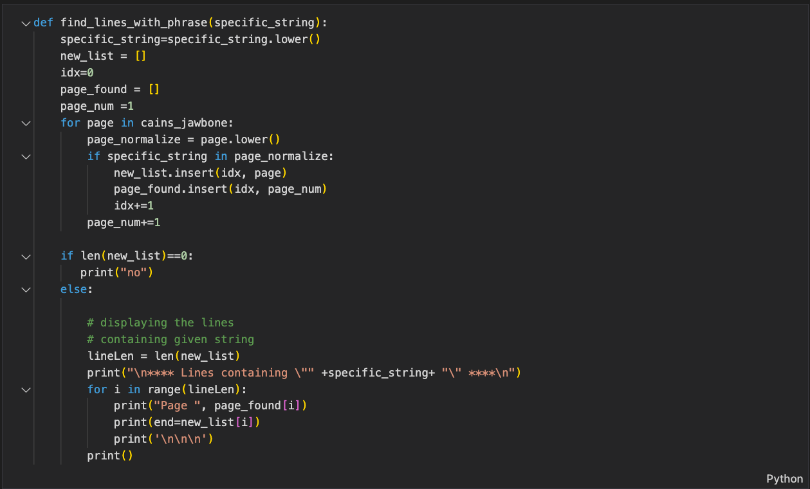
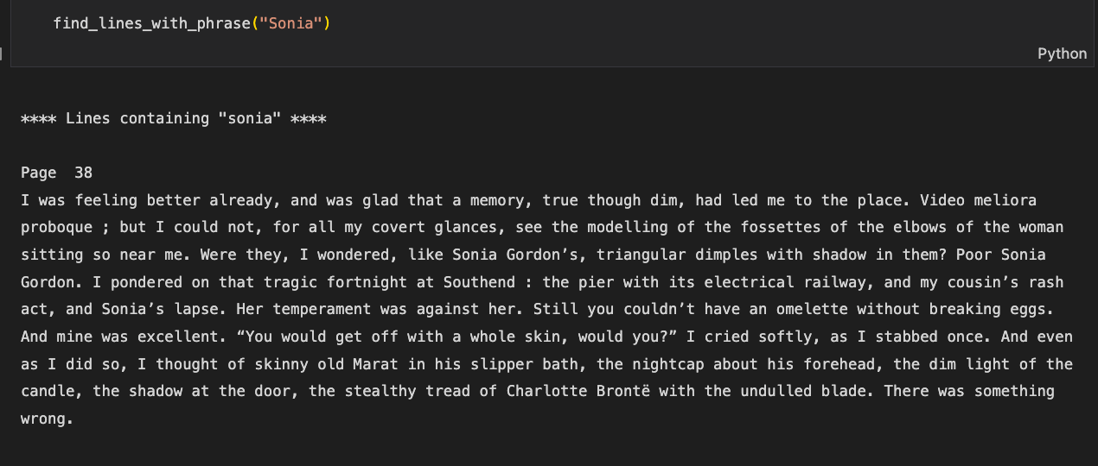
Faster way to model in Arango?
Return matches based on a relevancy score?

Slide 5
Questions
Views:
What is the purpose of views?
How would configuring views help my use case?
Analyzers:
Possibilities for NLP?
Configuring Geospatial Capabilities

Slide 6
Questions
Rules:
Narrator Example:
Page 43 is narrated by Alexander.
If a page is narrated by a woman, the narrator cannot be Alexander.
Remove Alexander from list of possible narrators for that page
Page Connection Example:
Page 24 comes before page 16.
If page 49 comes before 24, it must also come before page 16
Mapping 100! Examples is too much to start, is there a good way to model this? (Markov chain in Arango?)

Slide 7
Questions
Dictionary
Semantics
Some words are used multiple times, with different semantics
Clement as a name vs a verb, Jasmine as a name vs the flower
Is there a way to detect these differences in context?
ArangoML
Free?

Slide 8
Any Ideas?

